Slide 1
Cultural Immersion
Name
Institution of Affiliation

Slide 2
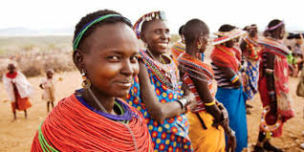
Introduction
African has a rich culture and traditions as a population.
The population has its roots from the African continent.

Slide 3
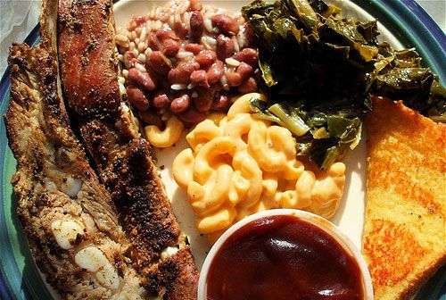
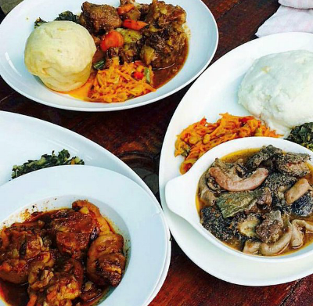
African Traditional Foods

Slide 4
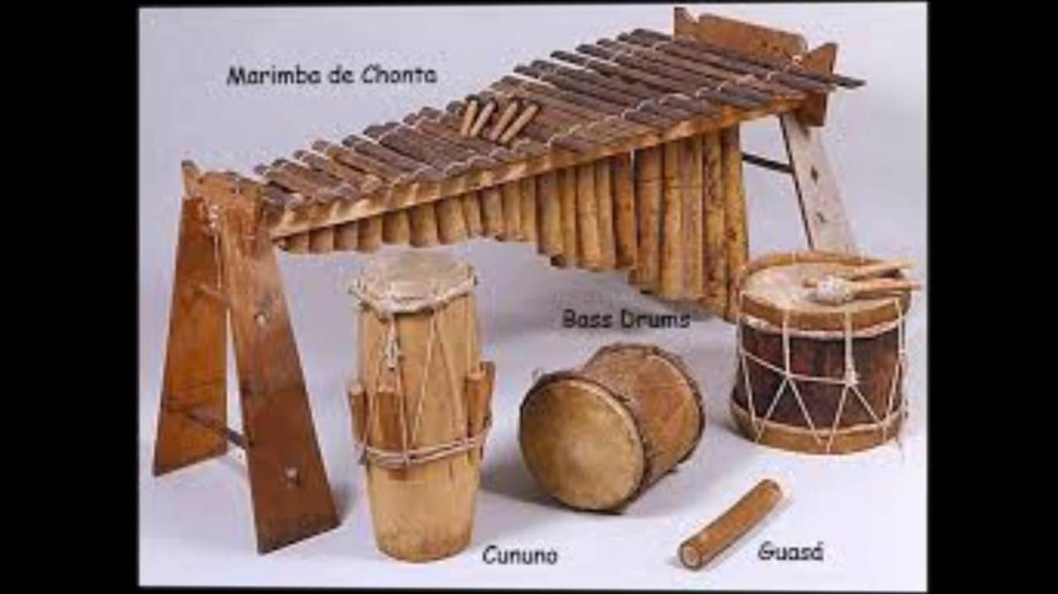
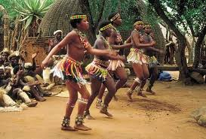
Traditional Music And Dance

Slide 5
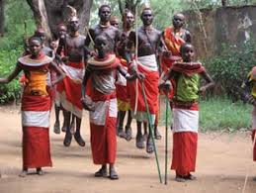
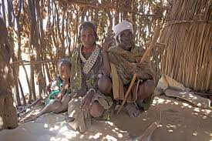
Attire And Clothing
The African had very unique clothing and attire…

Slide 6
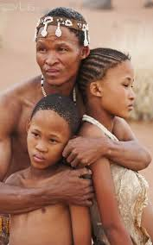
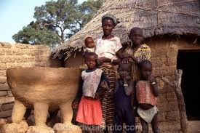
African Organized In Families
Family settings are very important part of the culture in African setting.

Slide 7
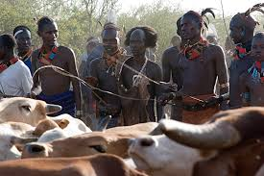
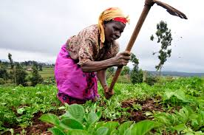
Roles and responsibilities
The roles are based on gender and age

Slide 8
Thank You

